Slide 1
Multi-Class Email Text Classification
Predicting the label/folder of an email with the metadata and content of an email.
Pedro Jr. Vicente Valdez
Arjun Patel
Rajan Dutta
June Namgung
INFO 154/254 - Data Mining and Analytics
Notes:
PEDRO

Slide 2
Introduction
For those who are committed to inbox zero
Labeling each email and finding emails with a certain label can be tedious
A solution to automatically organize an incoming email to its right:
Folder
Label
Category
How It Works:
User chooses the folders that they want to have
We use our trained model with all the labels that are options for the user
An incoming email will be grouped into one of the chosen labels
Notes:
ARJUN

Slide 3
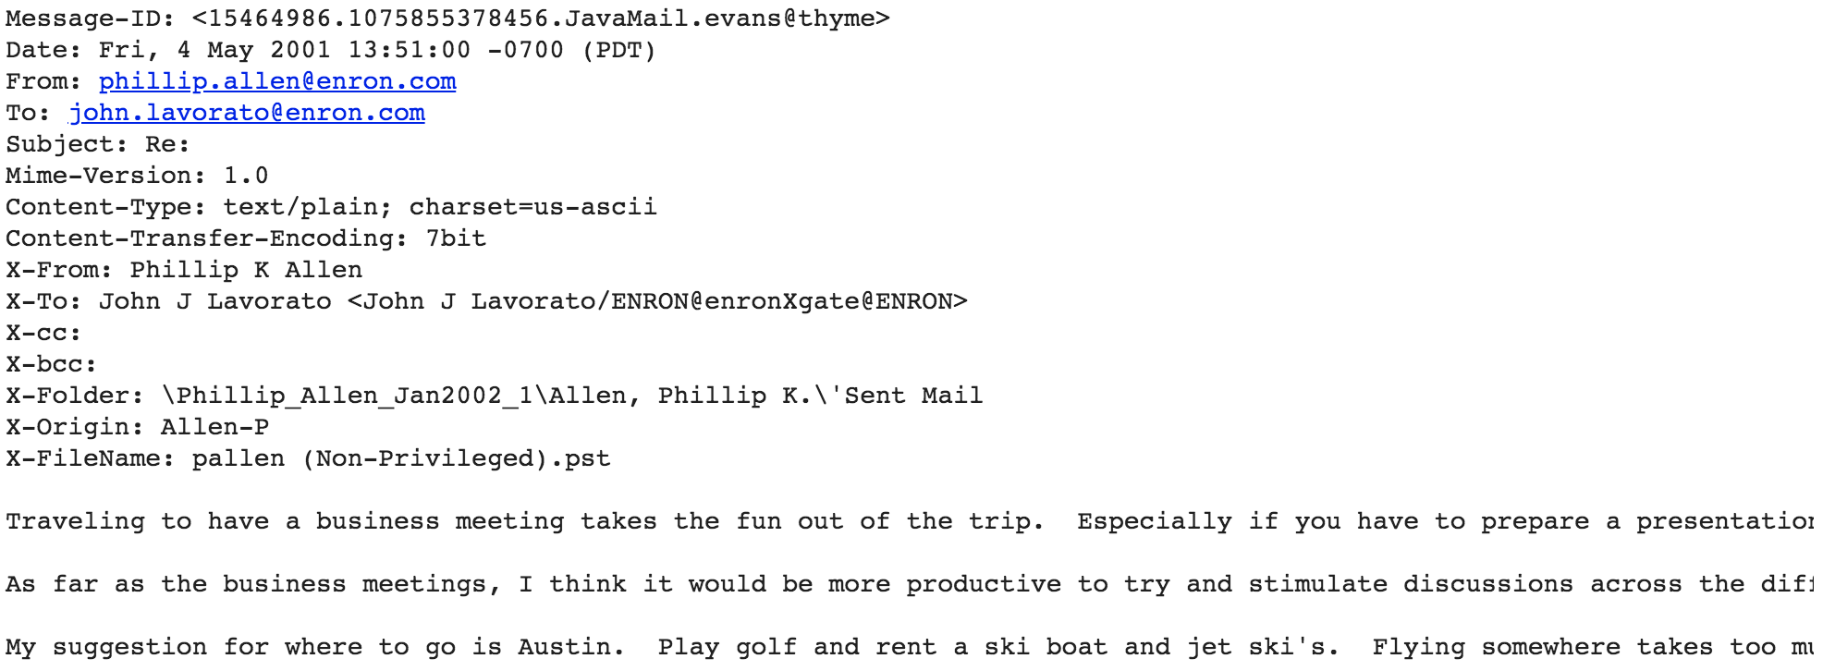
Dataset - Enron Email Dataset
It contains 517401 rows corresponding to emails generated by employees at the Enron Corporation, mostly senior management.
Originally published by the Federal Energy Regulatory Commission during the investigation of Enron’s collapse in December of 2001.
Two Columns: File and Message

Slide 4
Research Questions - Goal
Questions
What do we need to successfully build an email classification tool?
What kind of preprocessing and feature engineering is useful and adequate for text classification problems?
What type of models can we use?
Are there some models that perform better in text classification problems?
How do we improve and/or optimize said model?
Goal
Build a Multi-Class Email Text Classifier Model initially targeted toward companies/enterprises.
Notes:
PEDRO

Slide 5
Independent Variables
Embedded message
Convert each email message to a 300-length vector embedding
Message characteristics
Message length
Email characteristics
Day of week (as one-hot-encoding)
Day of week (mapped value)
Contains CC or BCC
Occurrences of email labels in body
Index | Message Length | Day= Sunday | ... | Day= Saturday | Embedded vector, Dimension 1 | ... | Embedded vector, Dimension 300
Notes:
Cc: carbon copy : Put the email address(es) here if you are sending a copy for their information (and you want everyone to explicitly see this)
bcc : blind carbon copy: Put the email address here if you are sending them a Copy and you do not want the other recipients to see that you sent it to this contact

Slide 6
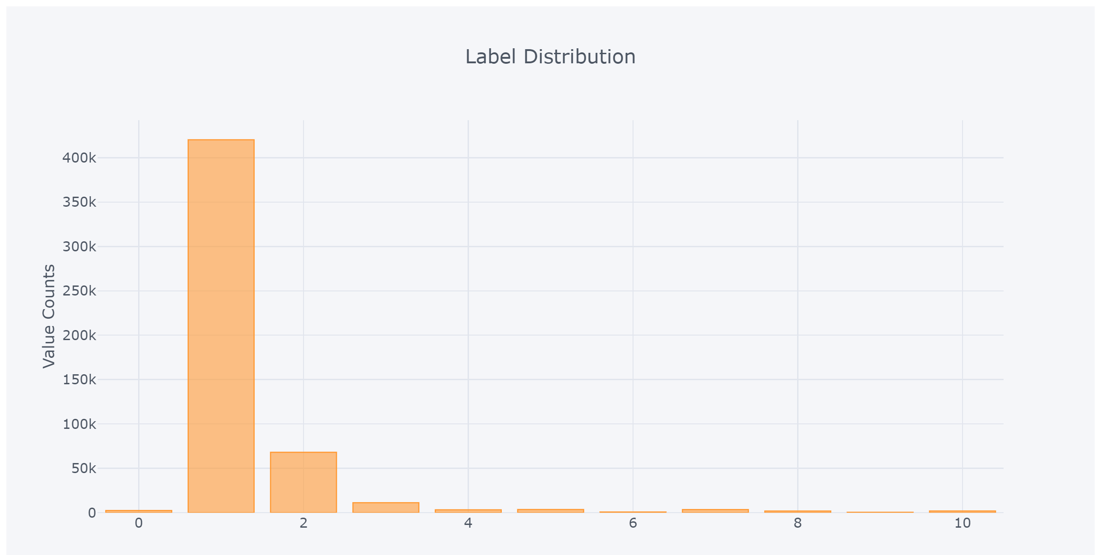
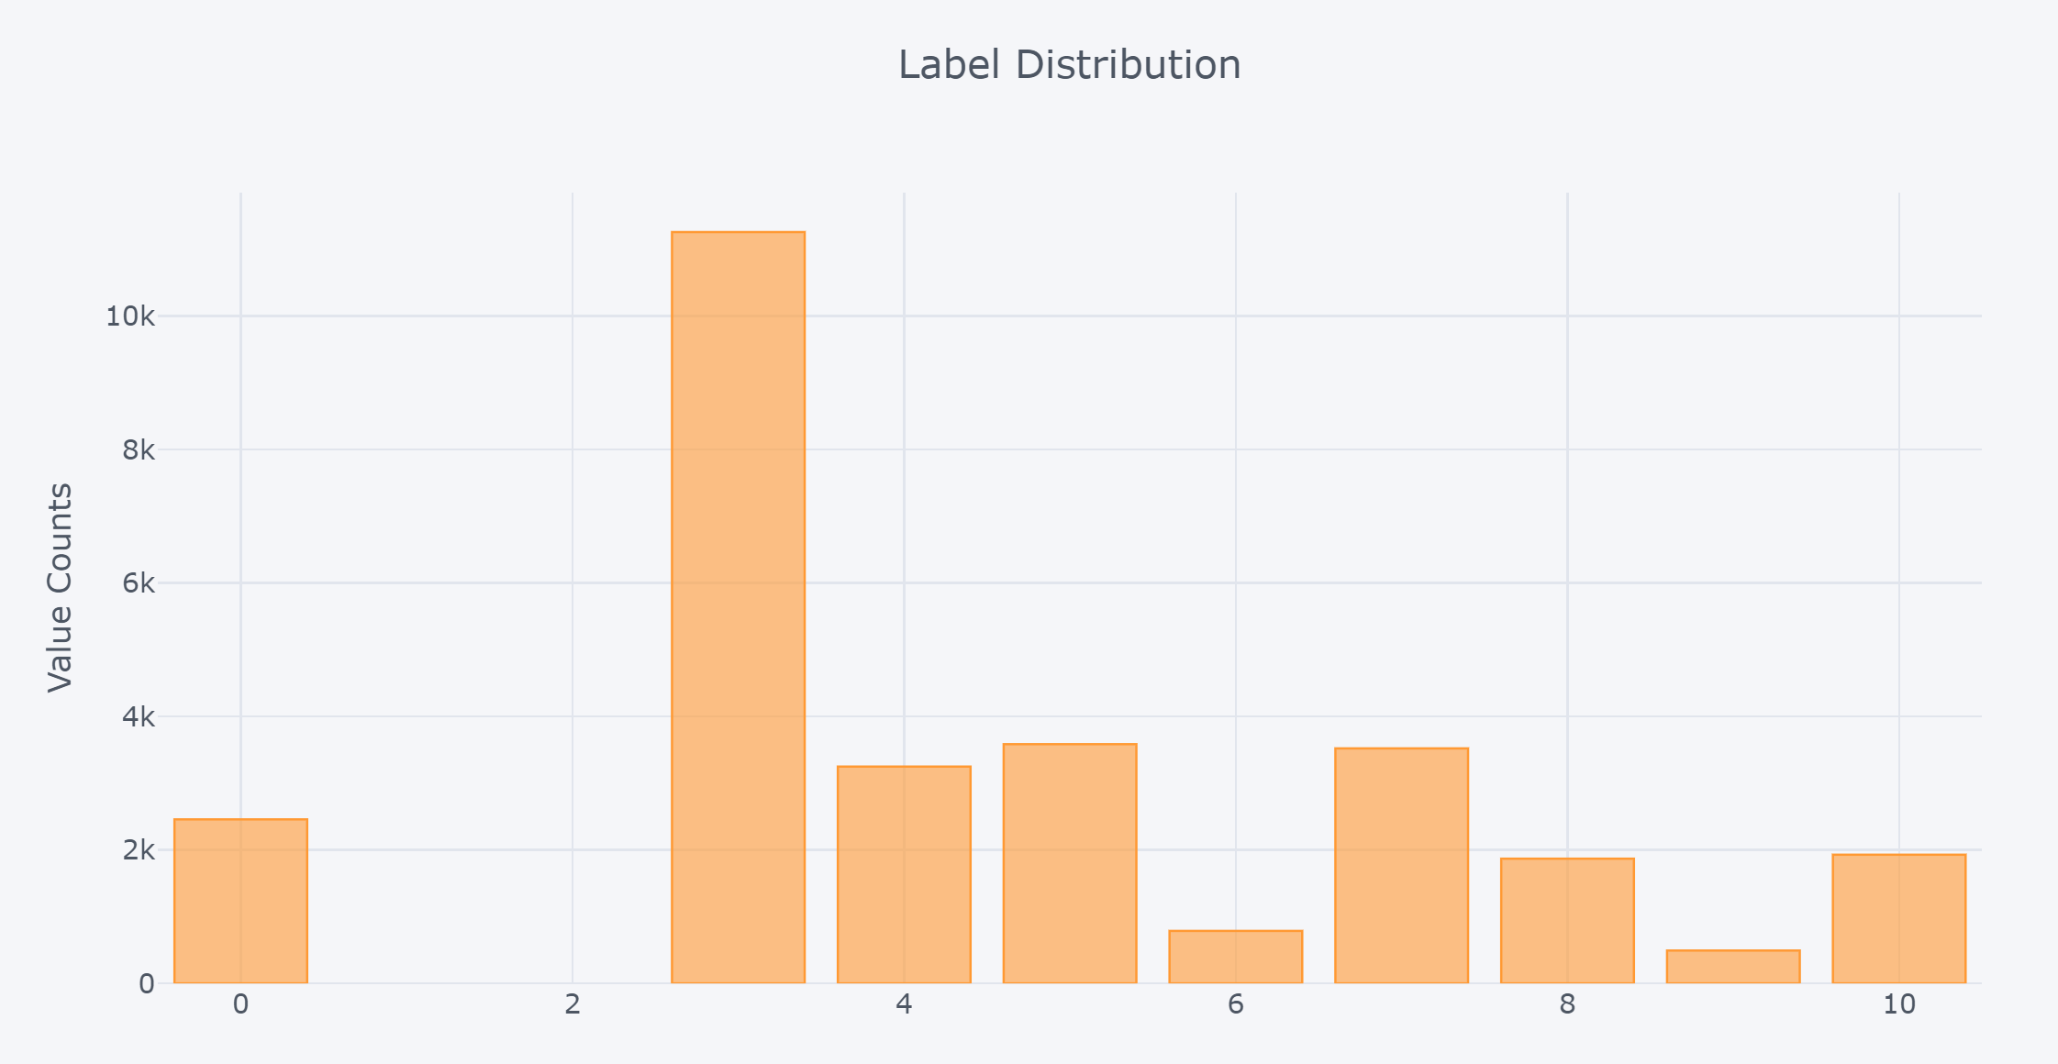
Dependent Variable: Folder Labels
Original dataset included 1,700+ folders
Using KMeans clustering and some manual edits, we create 11 clusters
Most emails in ‘Sent’ or ‘Documents’ or similar (labels 1 and 2) so we exclude those labels and train only with labels 0 and 3-10

Slide 7
Models
Decision Tree, Random Forest, Bagging, LSTM

Slide 8
Decision Tree

Slide 9
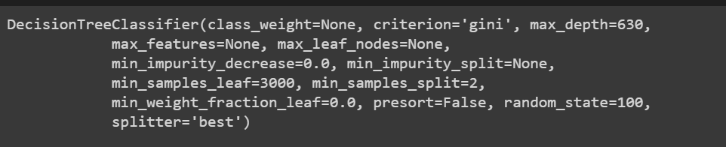
Decision Tree
Attempted with different feature sets
Most effective with using gini index to find best splits
Max_depth altering got crazy when increasing too much
Likewise too small didn’t allow the visualization to split based on the entire embedding of the body
Min_samples_split
Max_leaf_nodes
Hit a plateau even after tuning the model

Slide 10
Random Forest

Slide 11
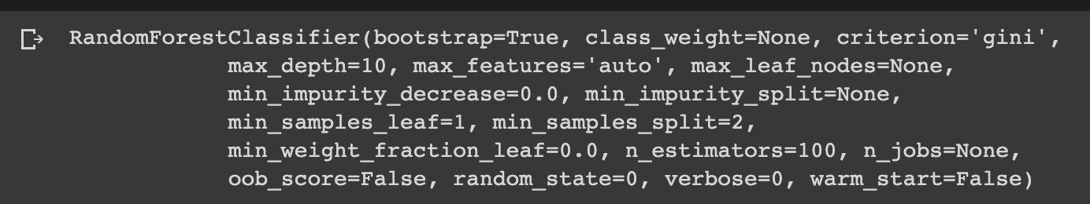
Random Forest
Attempt to beat the decision tree model
Still plateau in performance at about ~40% test accuracy
The hyperparameters such as max-depth didn’t quite help
Perhaps needed better feature engineering

Slide 12
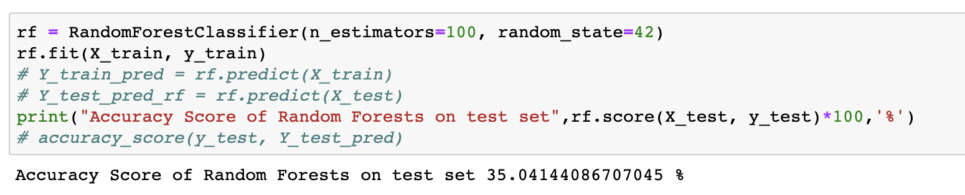
Random Forest
Attempt to beat the decision tree model
Still plateau in performance at about ~40% test accuracy
The hyperparameters such as max-depth didn’t quite help
Perhaps needed better feature engineering

Slide 13
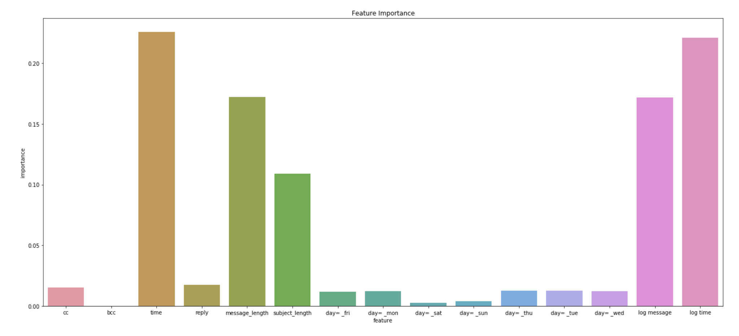
Random Forest

Slide 14
Bagging

Slide 15
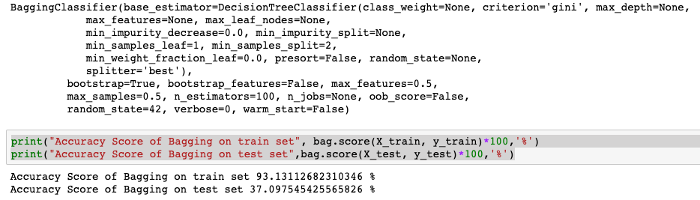
Bagging
Still plateau in performance at about ~40% test accuracy even with some more feature engineering e.g. stopwords

Slide 16
KNN

Slide 17
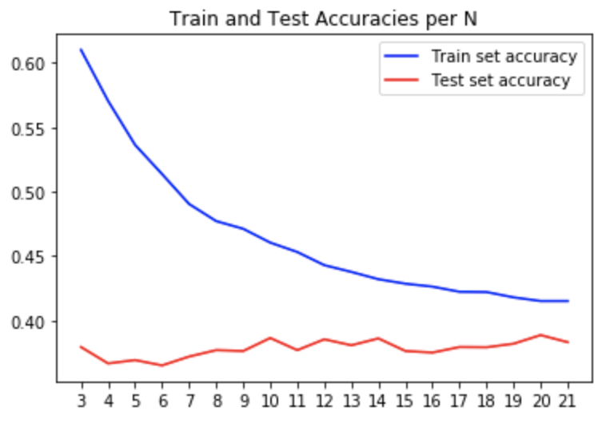
KNN Model
Experimented with various values for the number of neighbors to look at
Found that n = 21 performed the best (least overfitting)
Overall, very weak performance from the KNN model
The data is too complex and the clusters aren’t distinct enough for KNN to succeed

Slide 18
Long Short Term Memory Neural Network (LSTM-NN)

Slide 19
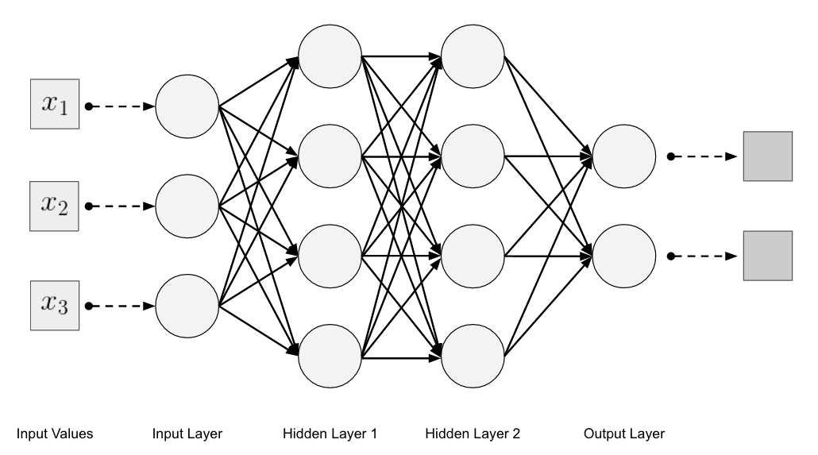
LSTM Neural Network Overview
SOFTMAX Activation Function
Embedding
LSTM (100-unit)
11-Unit Dense

Slide 20
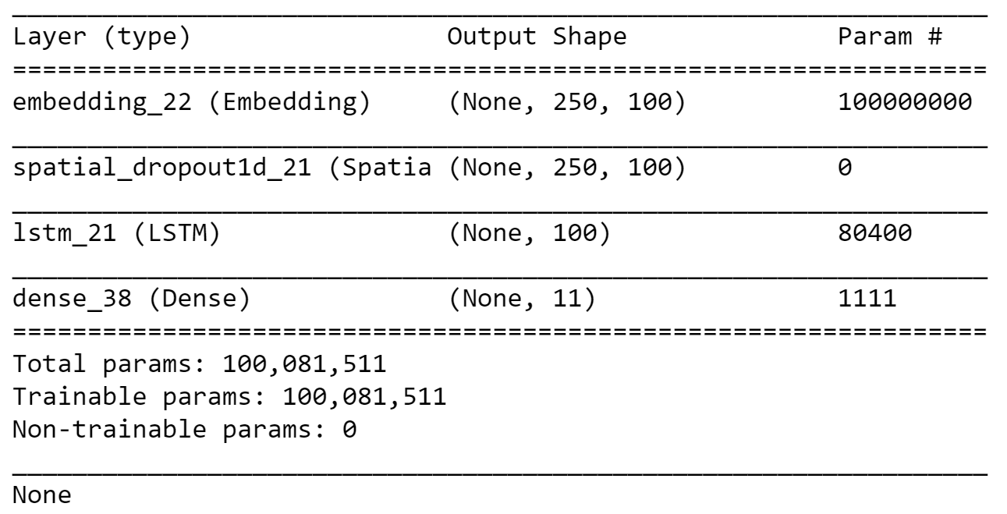
LSTN-NN
Loss Metric:
Categorical Cross Entropy
Grid Search:
Dropout: [0.2:0.5]
BatchSize: [50,100,150]
LSTM Unit: [50, 100, 150]
Optimizer: [Adam, SDG, Adagrad]
Embedding Layer
(250 Vector Input)
Spatial Dropout
100-unit LSTM Layer
11-unit Dense Output
Softmax Function

Slide 21
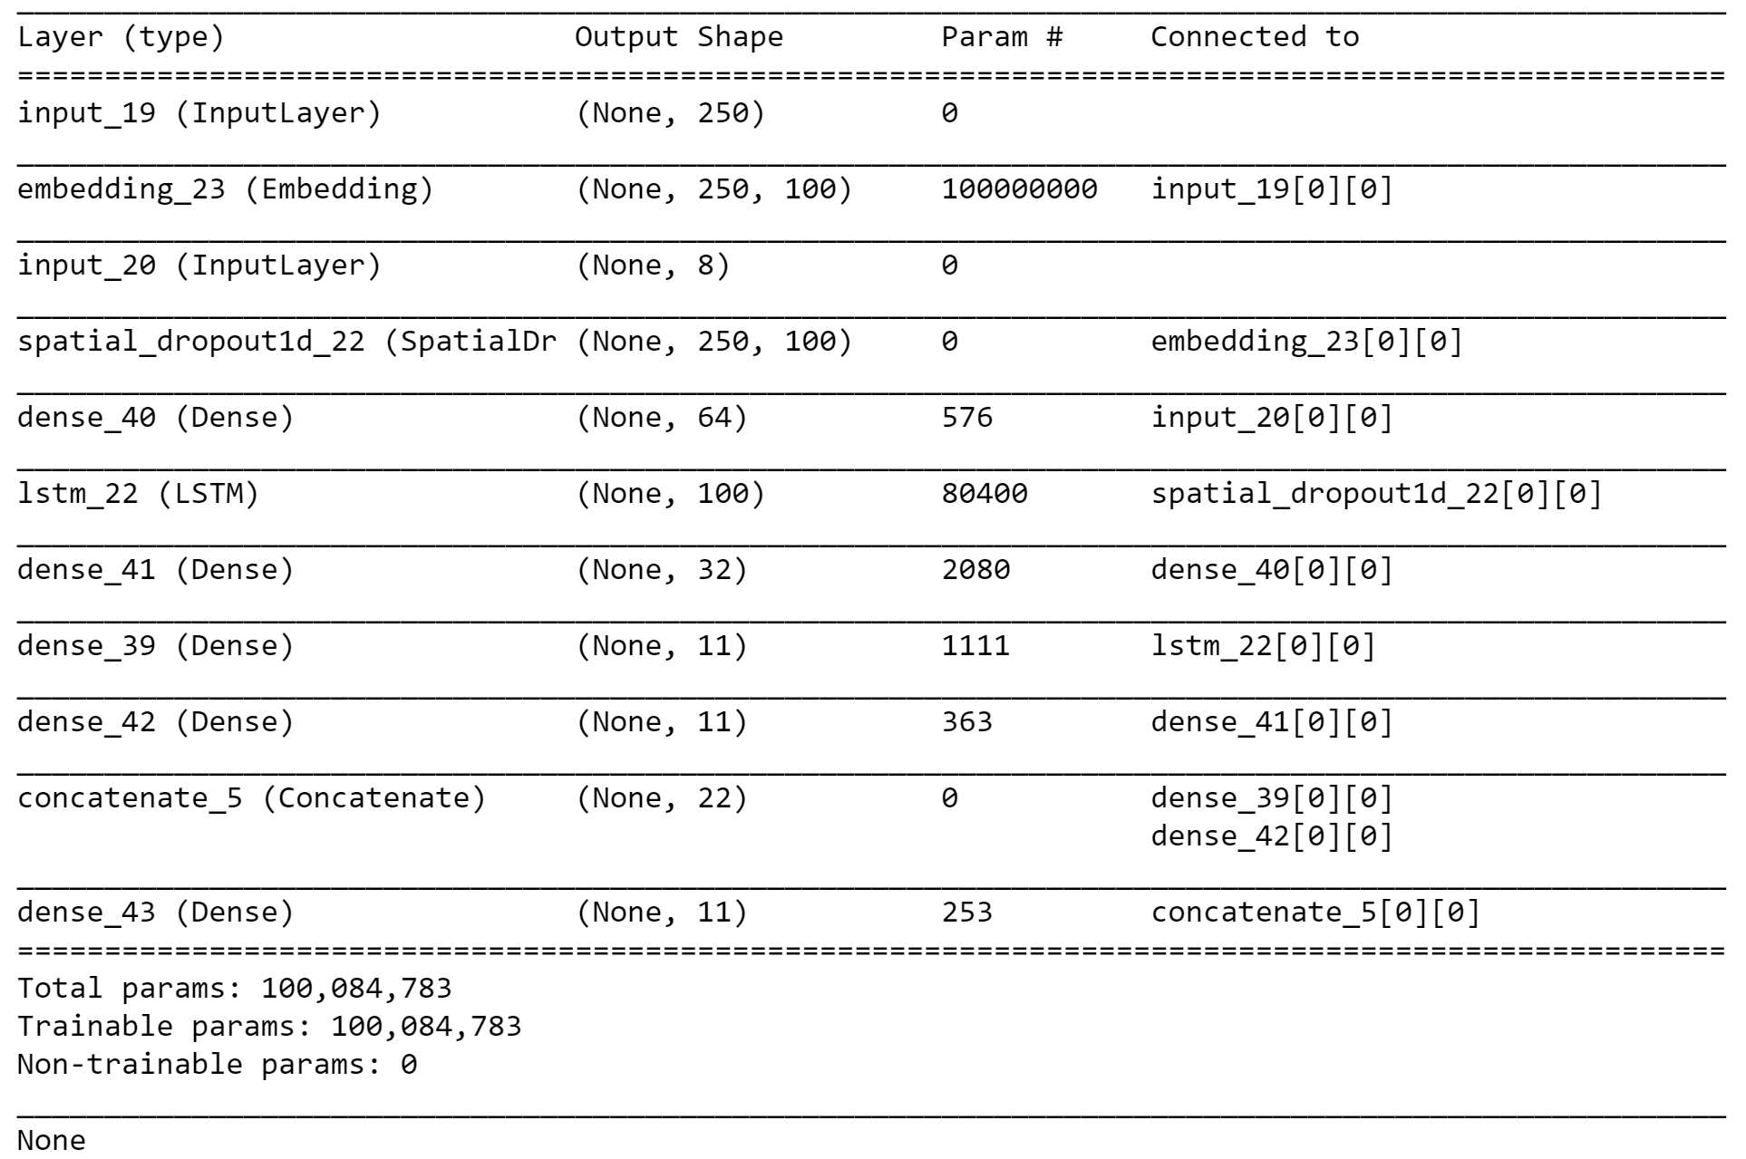
Alternative Approach (Failed)

Slide 22
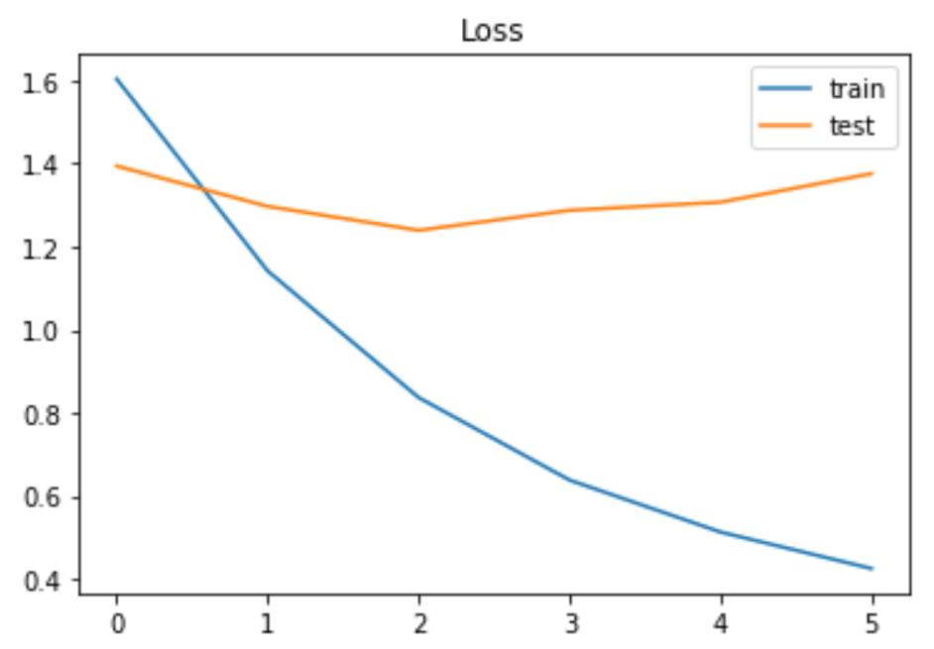
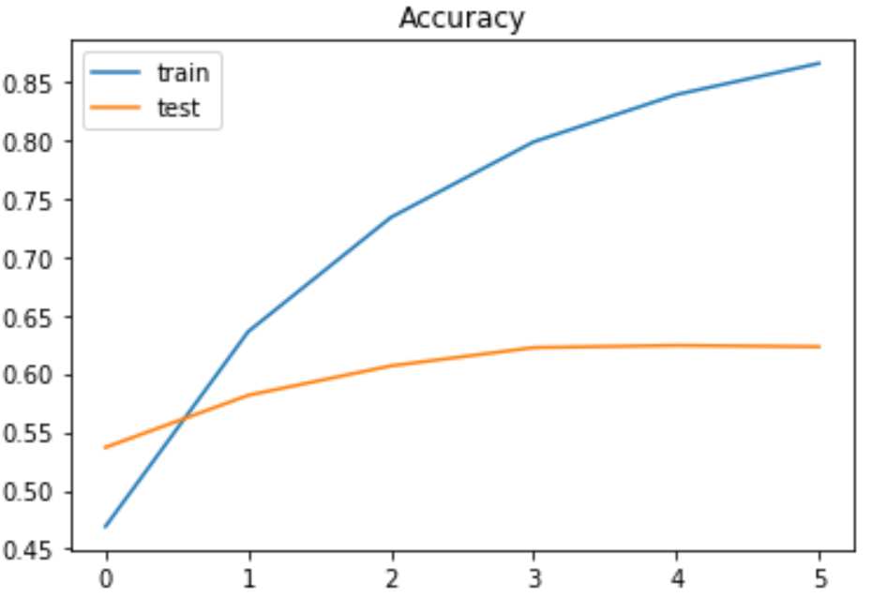
LSTM - Loss and Accuracy
Good Accuracy for the Training Data, Moderate in Test Data
Overfitting Issue

Slide 23
Testing LSTM Model

Slide 24
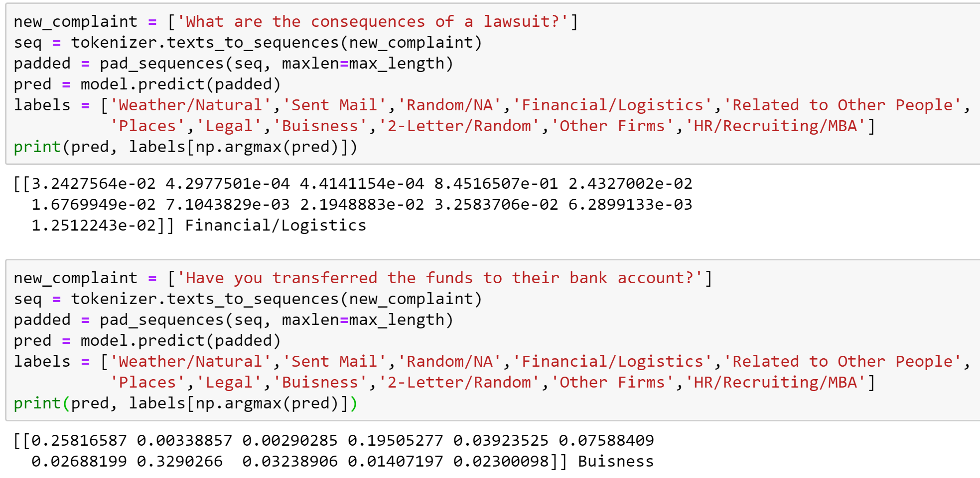

Slide 25
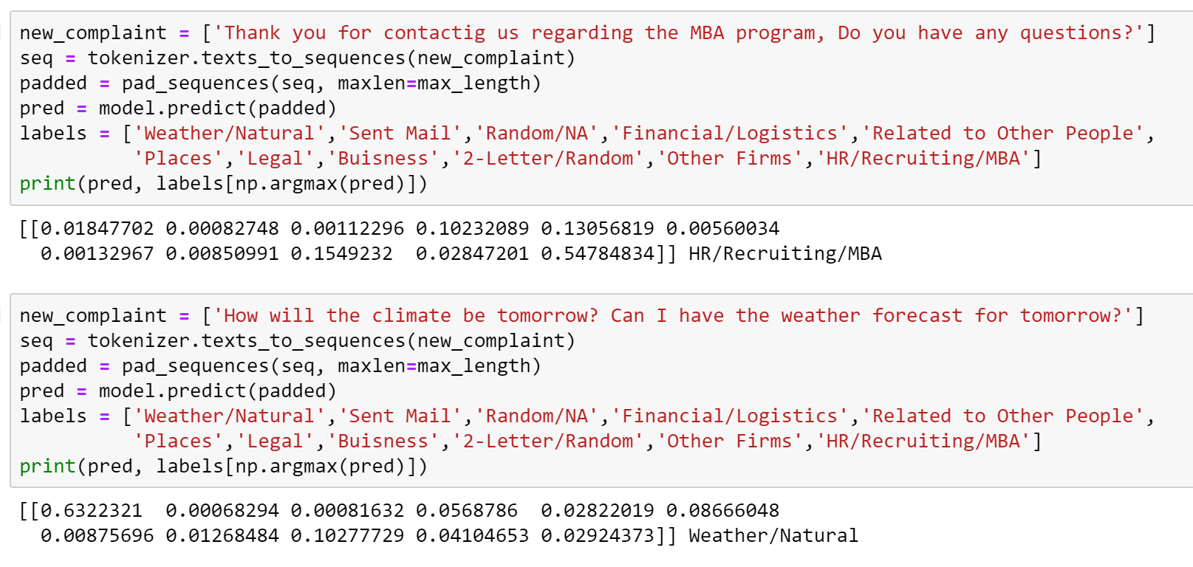

Slide 26
Conclusion

Slide 27
Conclusions and Future Work
Conclusions
Traditional models such as KNN, Decision Tree, and Random Forest were ineffective due to data complexity
LSTM performed the best because its ability to remember past information in an email allowed it to better classify
Future Work
Expanding to Multi-Class Multi-Label Classification
Try SVM models
Making it more consumer friendly as a plugin
Integration with Gmail or a third party client
Deploy model with our own web app

